Slide 1
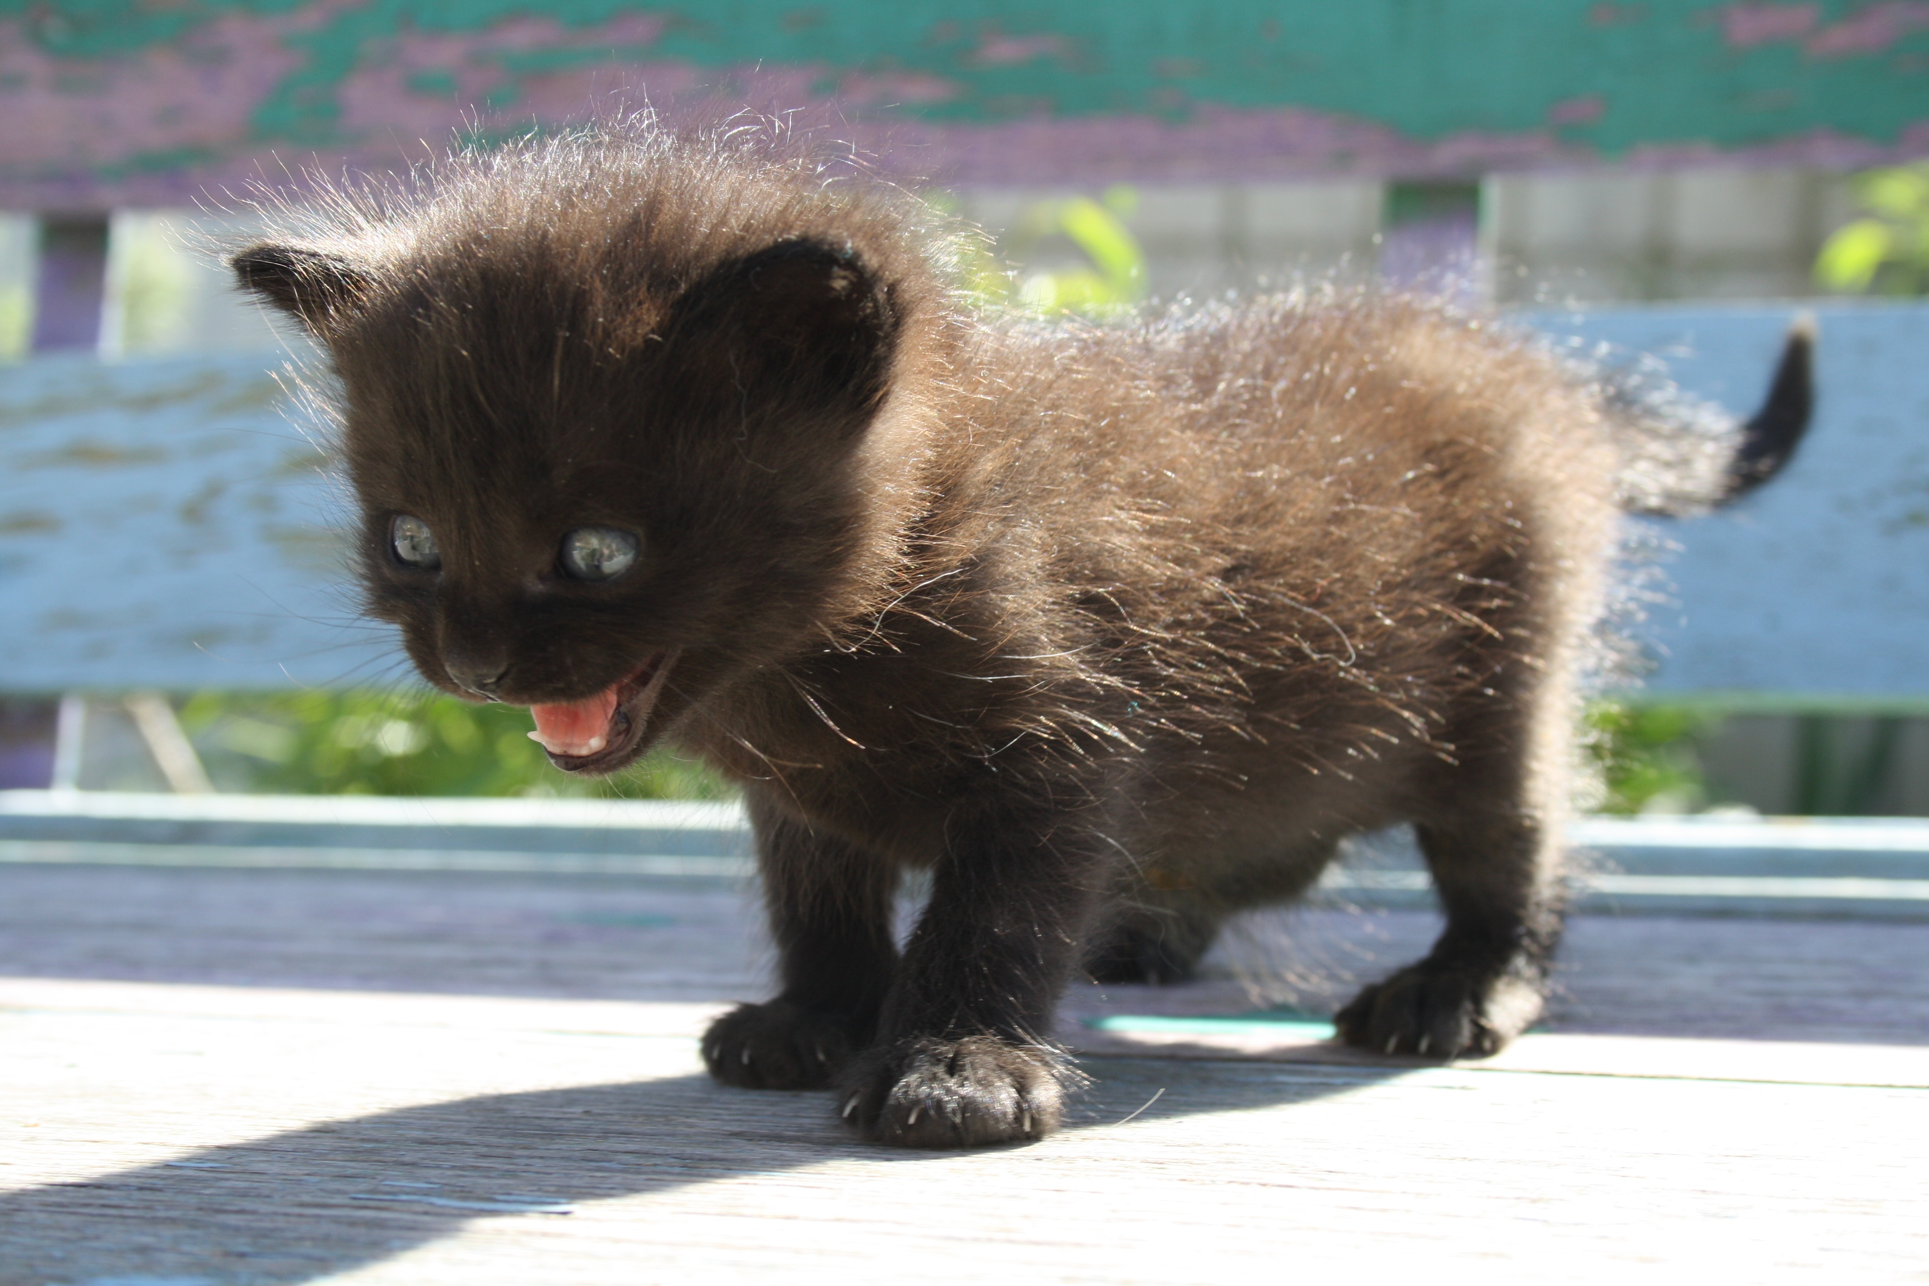
EVIL USER INTERFACE
By Chris and Caleb
An Exercise in Pain

Slide 2
Project Goals:

Slide 3
Project Goals:
Annoy people who use our app

Slide 4
Project Goals:
Annoy people who use our app
Nailed This one

Slide 5
Project Goals:
Annoy people who use our app
Make Mattheus cry

Slide 6
Project Goals:
Annoy people who use our app
Make Mattheus cry
Yet to nail this one

Slide 7
Project Goals:
Annoy people who use our app
See how many cool things we could add to our app
Learn how to use the WPF interface

Slide 8
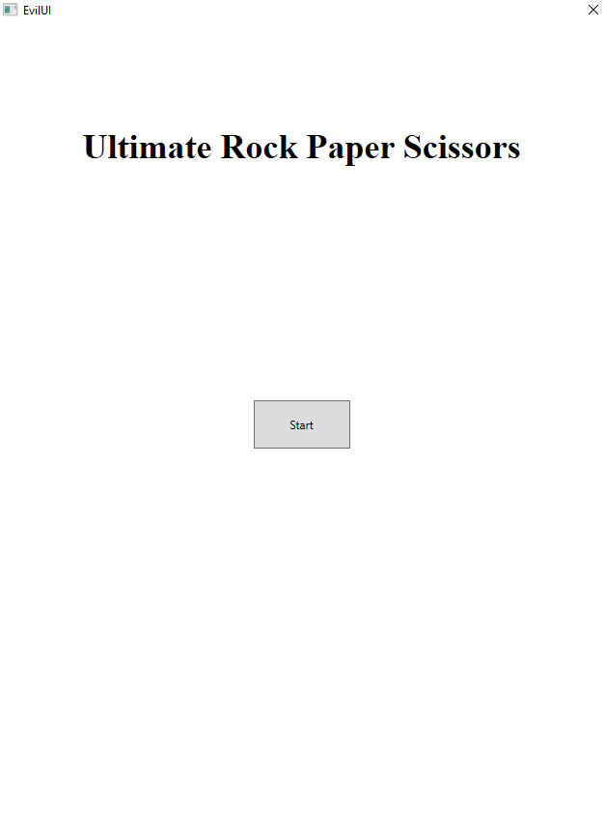
The Fabulous Starting Page
-Button utilizes options for changing cursor
-Button must be pressed a randomly determined number of times

Slide 9
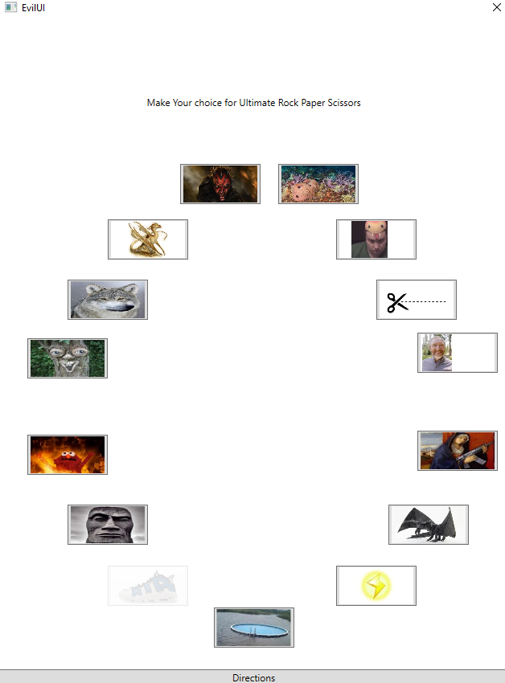
The Mighty Selection Screen
-Names for image files and the tags associated with each button are established through enum class to keep a consistent naming convention
-Buttons move and randomly change their image file and tag when the cursor touches them
-Button will only allow selection after all images are have the same tag (and image)
-Directions Button designed to disappear after being pressed once

Slide 10
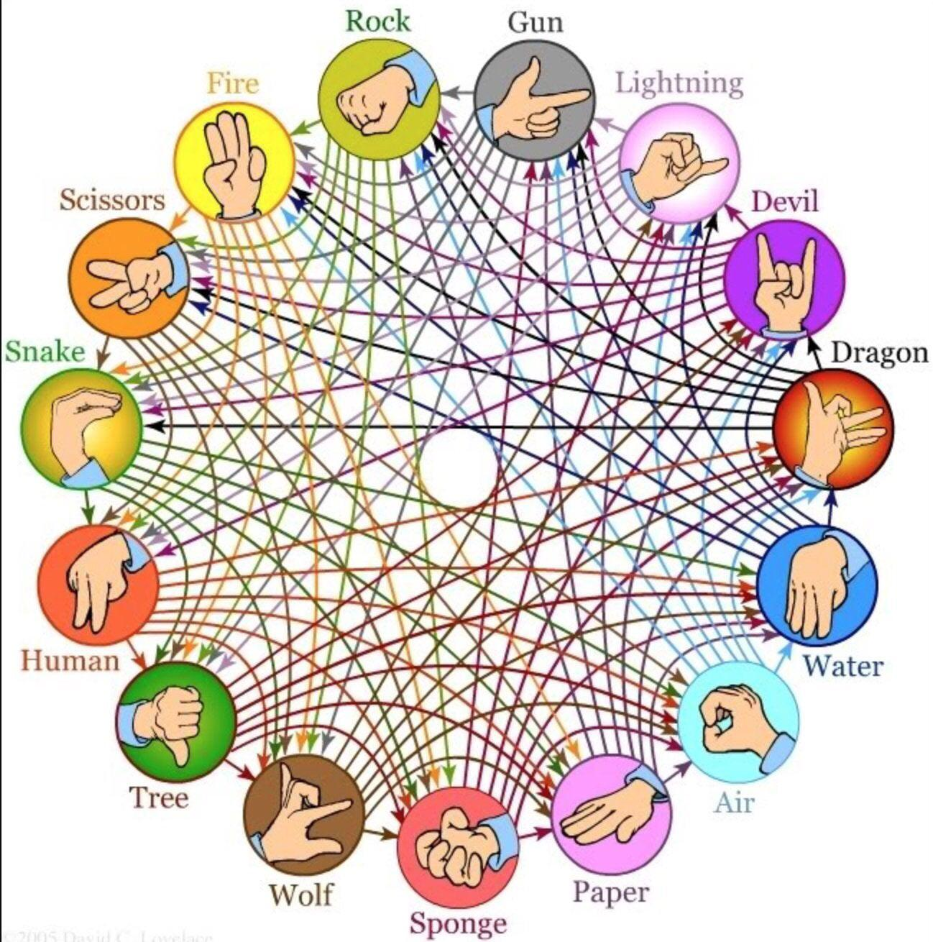
The Dastardly Directions

Slide 11


Slide 12
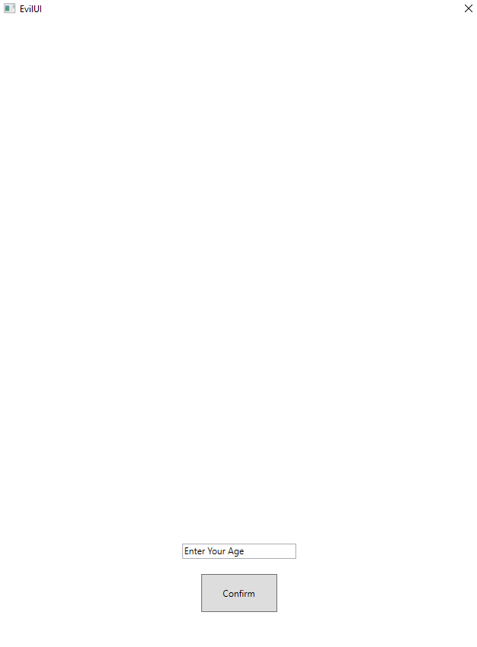
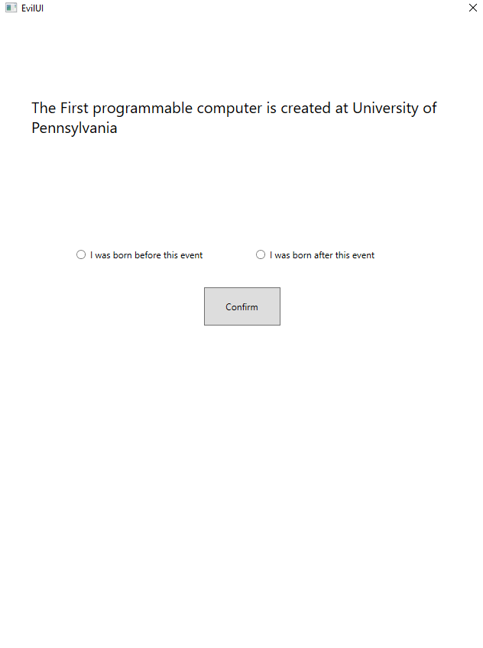
The Easiest-to-use age verification method ever devised by mortals

Slide 13
The Easiest-to-use age verification method ever devised by mortals –Unless you are American
-Each world event is tupled with the year it occurred and both are stored in a container (in chronological order).
-Each before/after choice adjusts the min/max of a function that randomly selects the next world event to display.
-Process ends when the min and max are narrowed down to two neighboring indexes
-Age provided by user is compared to length of time since the min and max world events.

Slide 14
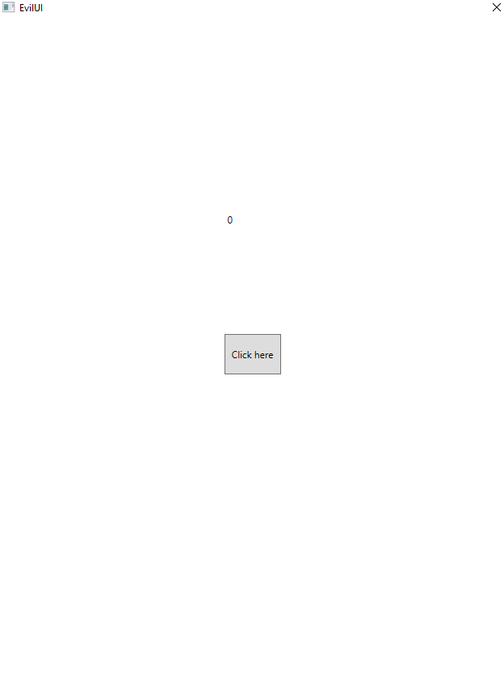
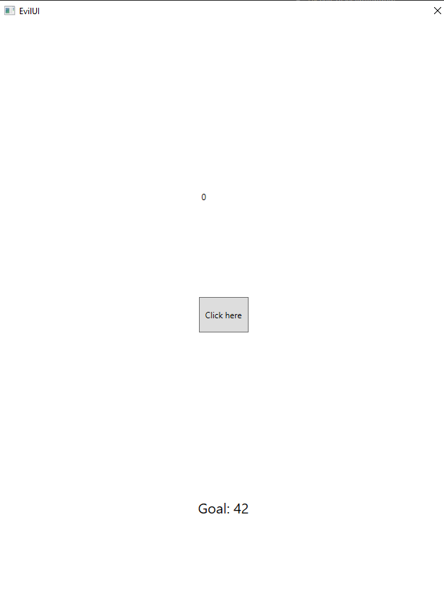
The "Encouraging" Counter
-Clicking the button increases the counter by a random amount
-If target number is skipped, the counter must reach 999 before returning to 0
-After each time the counter reaches 999, various message boxes are shown and labels made visibile

Slide 15
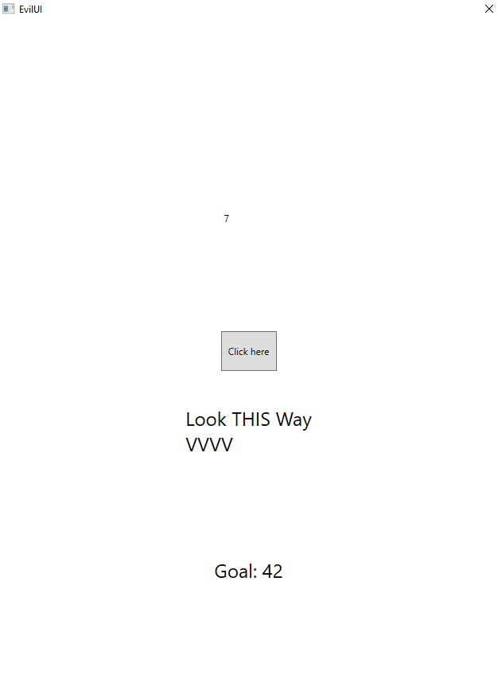
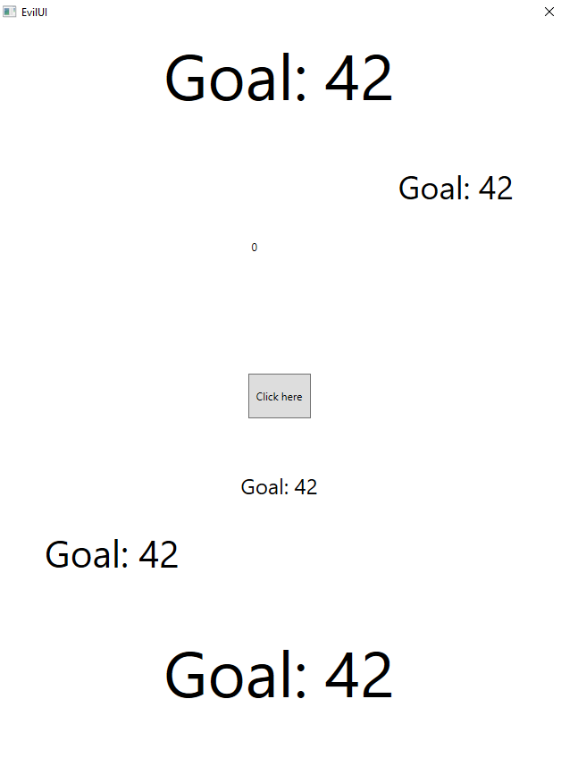
The "Trying to Help" Counter
-New labels are made visible and old are collapsed
-The font of the bottom label ever increases
-The contents of the label are also changed until...

Slide 16
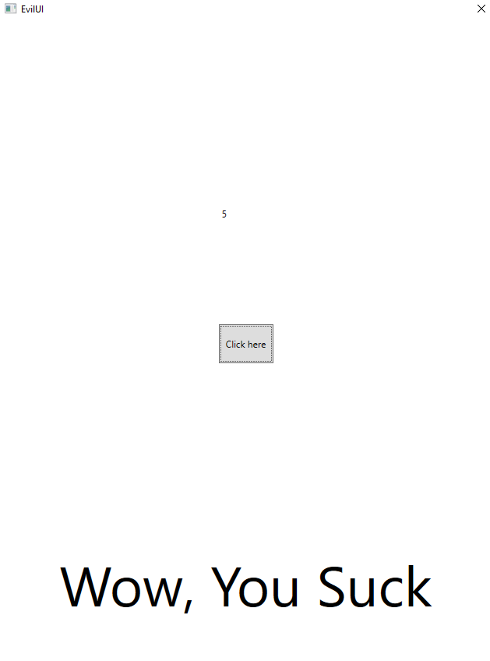
The "Fed up with you" Counter
The user is given a final assessment of their ability to hit the target number
Also, with every instance of the counter reaching 999, there is a 5% chance of being sent back to the Selection Screen

Slide 17
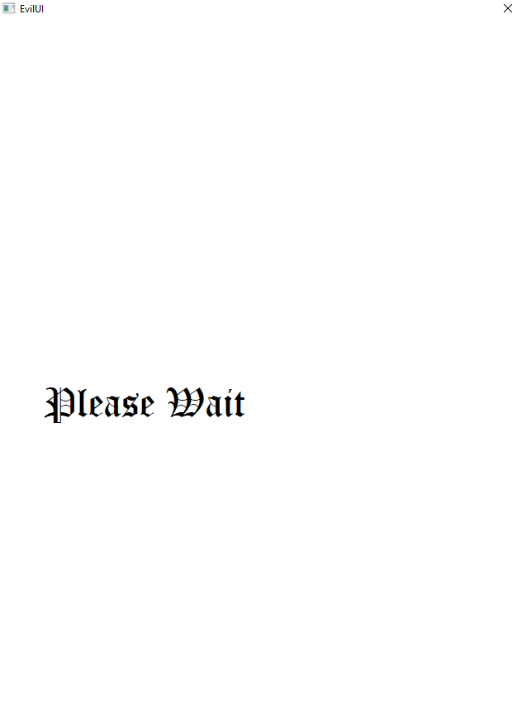
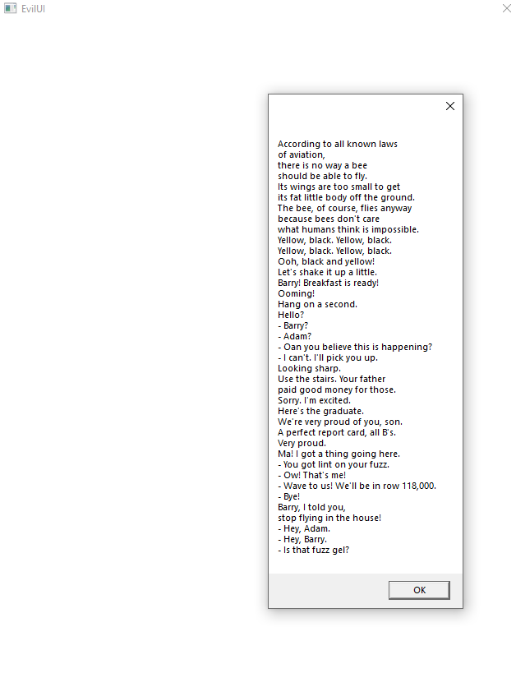
The Waste of Time

Slide 18
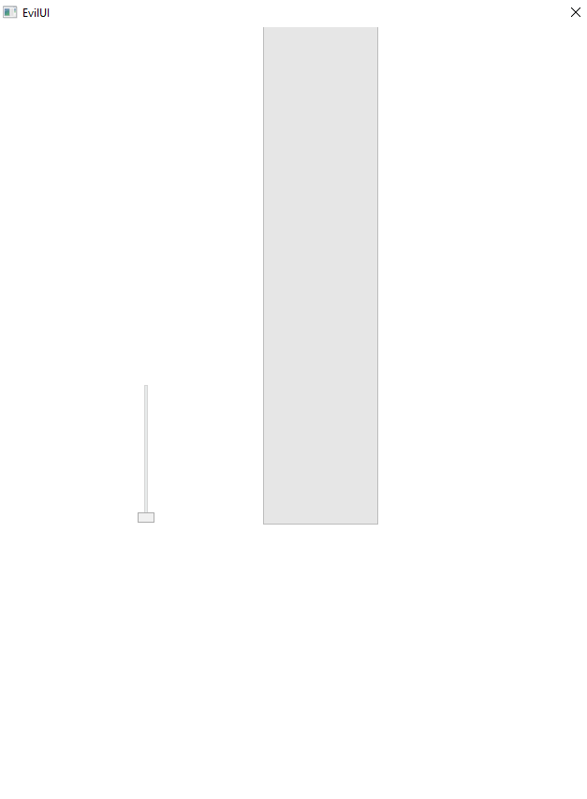
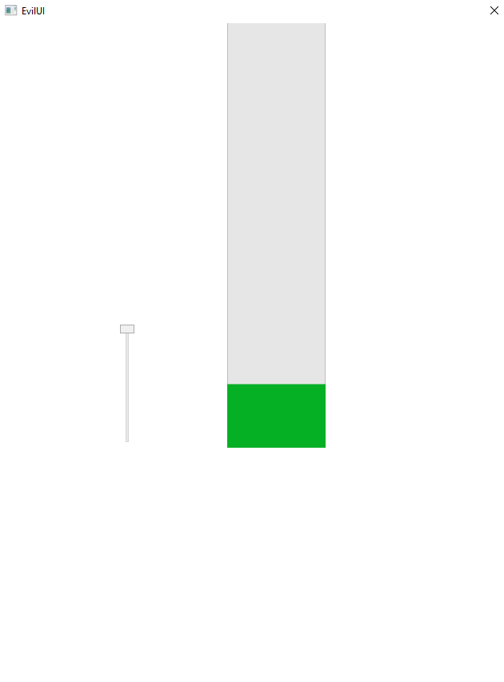
Getting Pumped

Slide 19
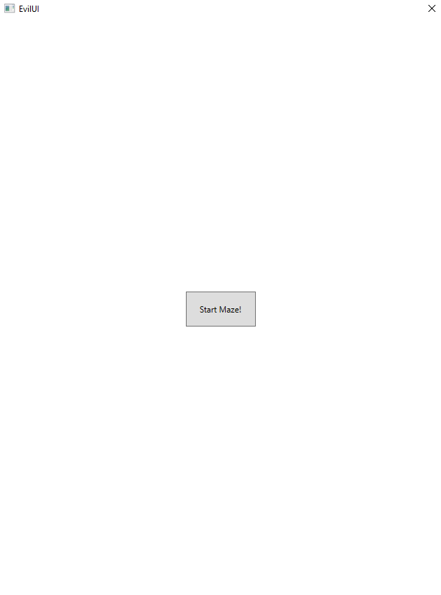
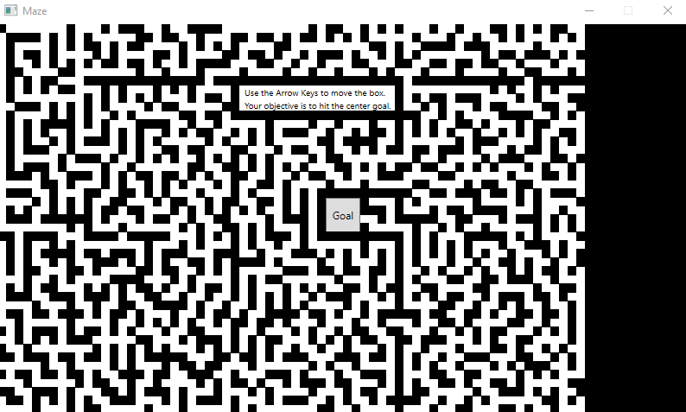
The Maze of Madness Caleb's Magnum Opus

Slide 20
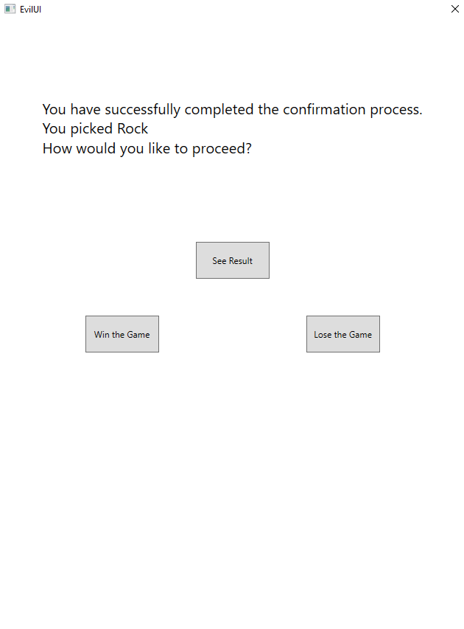
The Impossible Choice
-The Lose Game button just takes the user back to the Selection Screen
-The Win Game button toggles a bool that determines IF the See Result button will allow the player to win.
-The See Result button finally generates the computers Rock/Paper/Scissor choice and determines a winner. If the bool associated with the Win Game button is not true, the player will always lose.

Slide 21
Now let's look at Code

Slide 22
What we would have done differently
More robust planning
Doing different windows for each puzzle
Be mindful of the need for resetting puzzles

